Slide 1

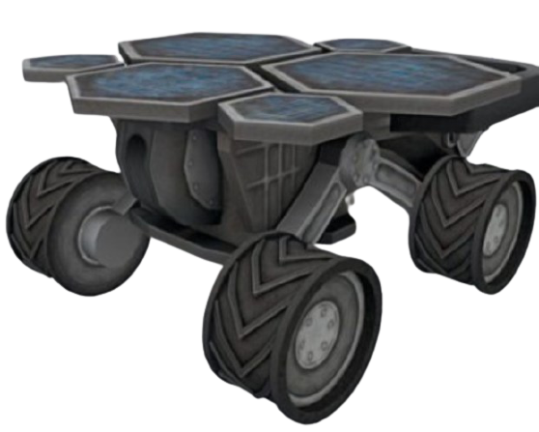
RoverSim
By:
Aman Vishwakarma
Brahatesh Vasantha
Harshini Sendhil
Prashant Gupta
Ankit Dudi

Slide 2
Aim
Using a path planning algorithm to autonomously navigate in a given area for a robot model with appropriate sensors using ROS navigation stack by performing a simulation of robot model in Gazebo.

Slide 3
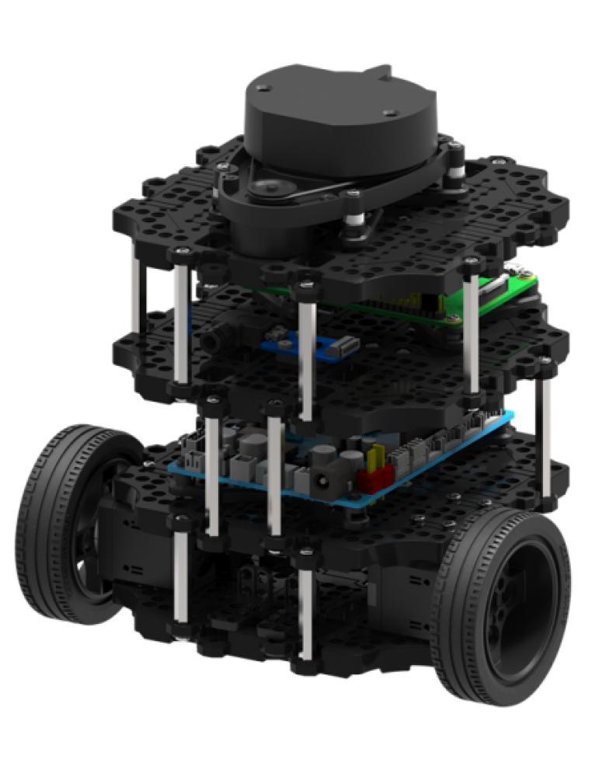


Components and Devices used
Robot Model : Turtlebot3 Burger
Sensors : LiDAR, Odometry
Meta-OS : ROS Melodic
Platform : Gazebo

Slide 4

Things learnt so far...
PID Controller
ROS Melodic Morenia
SLAM
Autonomous Navigation algorithms

Slide 5
Final Demo
Navigation (Dijkstra)
SLAM (EKF + Fast slam)
Navigation (Dijkstra)
SLAM (EKF)

Slide 6
Navigation
Algorithm used – Dijkstra
Path calculated using cost of each cell
Cost of a cell depends on number of cells crossed to reach it
Path which gives the least cost to the destination cell is selected

Slide 7
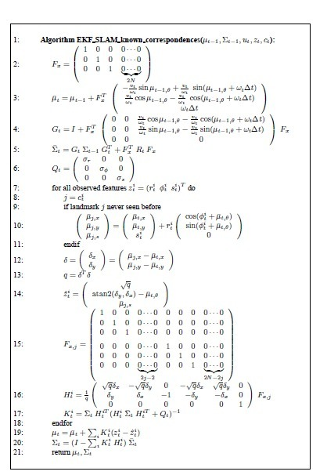
ASSUMPTIONS: Feature-based maps: Maps, in the EKF, are composed of point landmarks. For computational reasons, the number of point landmarks is usually small (e.g.,
smaller than 1,000). Further, the EKF approach tends to work well the less ambiguous the landmarks are. Gaussian noise: As any EKF algorithm, EKF SLAM makes a Gaussian noise
assumption for the robot motion and the perception.
EXTENDED KALMAN FILTER
(Online SLAM with known correspondences)
From Probabilistic Robotics

Slide 8

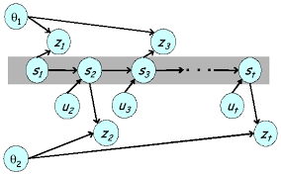
Future Add-ons & Improvements
Pose Estimation with ArUco markers
Fast Slam

Slide 9
Source Code
https://github.com/marsiitr/RoverSim

Slide 10
References
http://wiki.ros.org/
https://www.youtube.com/watch?v=ZmQIkBws4LA
https://www.youtube.com/watch?v=X30sEgIws0g&t=1632s&ab_channel=CyrillStachniss
https://www.youtube.com/watch?v=B2qzYCeT9oQ&list=PLpUPoM7Rgzi_7YWn14Va2FODh7LzADBSm&ab_channel=ClausBrenner
Probabilistic Robotics (Chapter 10)
https://dspace.mit.edu/bitstream/handle/1721.1/119149/16-412j-spring-2005/contents/projects/1aslam_blas_repo.pdf

Slide 11
Thank You!

